Slide 1
Node.js Course – 3rd Session
- ECMAScript 6 Overview
Lance Zhou
2016.08.28

Slide 2
Agenda
1
Preface
2
ES6 Features Overview
3
Block Scope
4
Arrow Function
5
Template String
6
Promise
7
Collection
8
Exercise

Slide 3
1
Preface

Slide 4
1
ECMAScript 6 VS JavaScript
ECMAScript is a standard
Implementation of ECMAScript Standard
JavaScript
Jscript
ActionScript
ECMAScript6 is also known as ECMAScript 2015

Slide 5
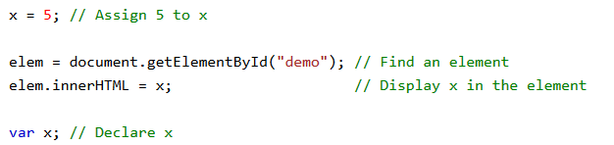
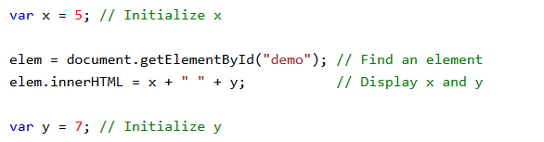
2
JavaScript Feature
Prototype
Weak typing
Function
Closure
Single-threaded
Scope
In JavaScript, scope is the set of variables, objects, and functions you have access to.
Hoisting
Hoisting is JavaScript's default behavior of moving declarations(var and function) to the top.
Only hoist declaration but not initialization

Slide 6
2
ES6 Features Overview

Slide 7
1
ES6 Features Overview
Block Scope
Arrow Function
Template String
Promise
Collection
Symbol
Class
Destructuring
…

Slide 8
3
Block Scope

Slide 9
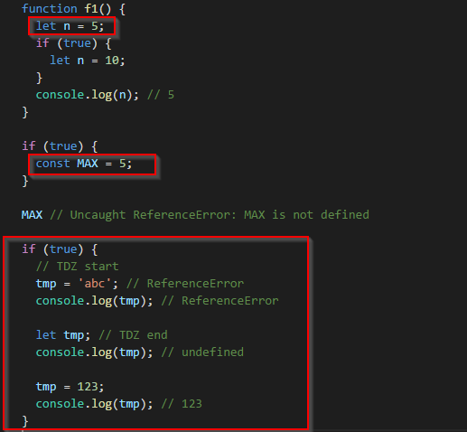
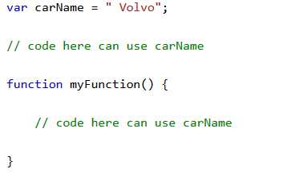
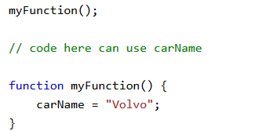
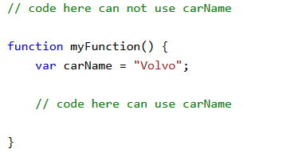
1
Global, Function and Block Scope
Global Scope
declare variable outside a function by keyword var
assign a value to a variable that has not been declared
Function/Local Scope
declare variable within a JavaScript function by keyword var
Block Scope
declare variable by keyword let or keyword const
No hositing
Temporal Dead Zone
Variables declared by let/const can’t be used before their declaration.
Notes:
In ES5, you had to use a pattern called IIFE (Immediately-Invoked Function Expression) if you wanted to restrict the scope of a variable tmp to a block:
(function () { // open IIFE var tmp = ···; ··· }()); // close IIFE console.log(tmp); // ReferenceError

Slide 10

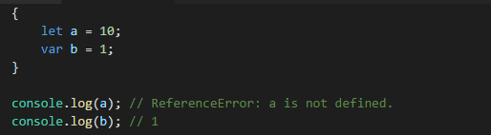
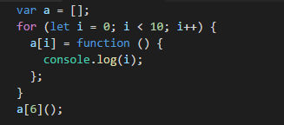
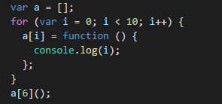
2
Block Scope – let
let is a new var
No hositing
Can’t declare duplicate variable in same block
Block is refer to function, for loop and if-else code block

Slide 11
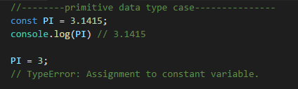
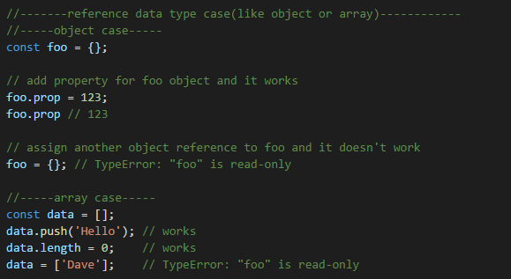

3
Block Scope – const
No hositing
Can’t declare duplicate variable in same block
Declare a read-only reference to a value
Initialization is needed when declare variables

Slide 12
4
Arrow Function

Slide 13
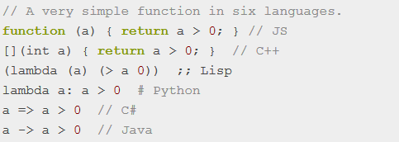
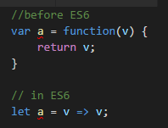
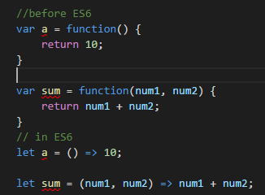

1
Arrow Function
A simple function in other languages
Function with one parameter
Function with 0 or * parameter
Function with codes more than one line

Slide 14
2
Arrow Function Rule
Replace anonymous function with Arrow Function
Don’t use arrow function when

Slide 15
5
Template String

Slide 16
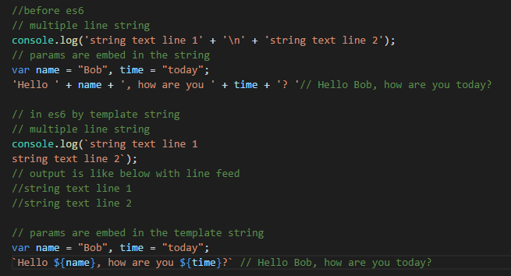
1
Template String
Declare by back quote ``
Template substitutions support any JavaScript expression
${any JavaScript expression}
Template String can be nested
Use backslash \ to escape `, $, { and } if they’re in string

Slide 17
6
Promises

Slide 18
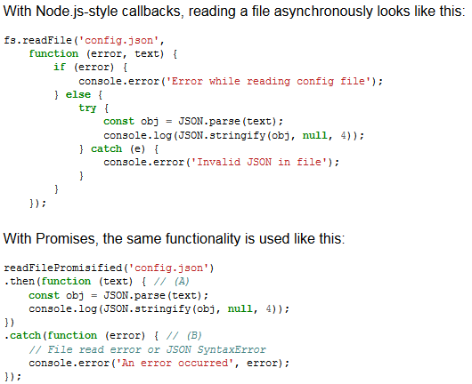
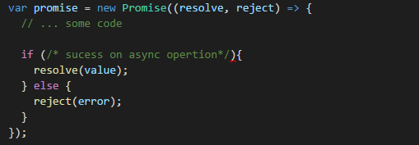
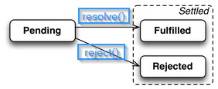
1
Promises Introduction
Promises are an alternative to callbacks for delivering the results of an asynchronous computation
Three ways to understanding Promises
calling a Promise-based function is blocking
A Promise is a container for an asynchronously delivered value
A Promise is an event emitter
In ES6, Promise is a construction function
After new a promise, it will be executed immediately
Promise instance has 3 mutually exclusive states
Before the result is ready, the Promise is pending.
If a result is available, the Promise is fulfilled.
If an error happened, the Promise is rejected.

Slide 19
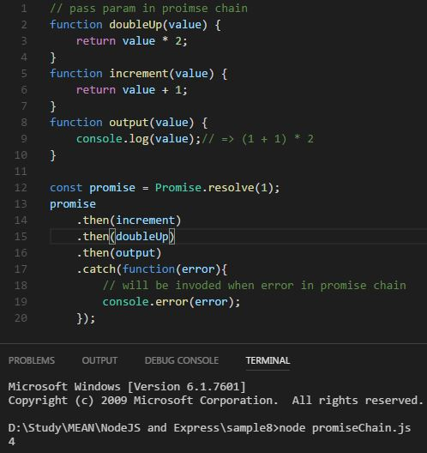
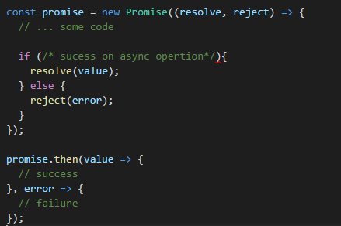
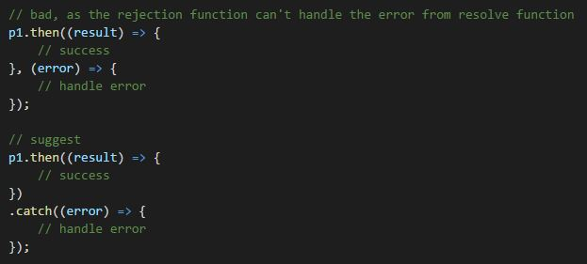
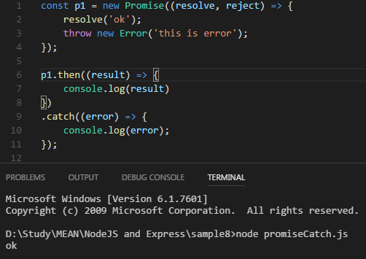
2
Usage of then, catch instance function
then() of a Promise instance
Define the callback function for fulfilled or rejected state
Promise Chain
Return a new promise instance
catch() of a Promise instance
Alias of then(null, rejection)
Can’t catch error after invoke resolve()
Notes:
Demo promise async chain with sample8/promiseAsyncChain.js

Slide 20
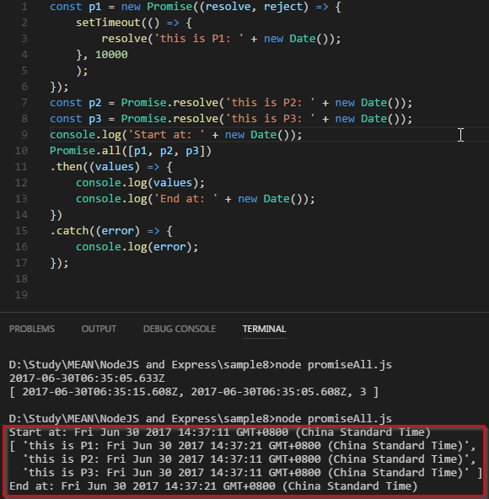
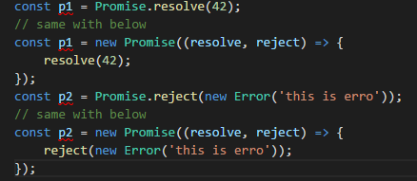
3
Usage of resolve, reject and all static function
Promise.resolve() and Promise.reject()
Quick way to new Promise
Thenable
Promise.all()
Accept an array of Promise object
All the promises are executed at the same time
Execute then() when all promises turn into fulfilled state
Execute catch() when any promise turn into rejected state
Notes:
Demo sample8/promiseAll.js

Slide 21
7
Collection
Notes:
http://i5ting.github.io/node-debug-tutorial/#701

Slide 22
1
Set and Map
Set
A construct function accepting array as parameter
Can’t add duplicate data
Map
Key can be arbitrary value including object
A construct function accepting array as parameter
WeakSet
Only accept object as Set element
Doesn’t prevent its elements from being garbage-collected
WeakMap
Only accept object(except null) as key
Doesn’t prevent its elements from being garbage-collected
Notes:
Demo sample8/collection.js

Slide 23
8
Exercise

Slide 24
1
Exercise

Slide 25
8
Reference
http://es6.ruanyifeng.com/#README
http://exploringjs.com/es6/

